Slide 1
Machine Learning 09- Unsupervised Learning
Dr. Malak Abdullah
Computer Science Department
Jordan University of Science and Technology

Slide 2
We will cover two topics
Unsupervised learning (ch 9)
Dimensionality Reduction (ch 8)

Slide 3
Unsupervised Learning

Slide 4
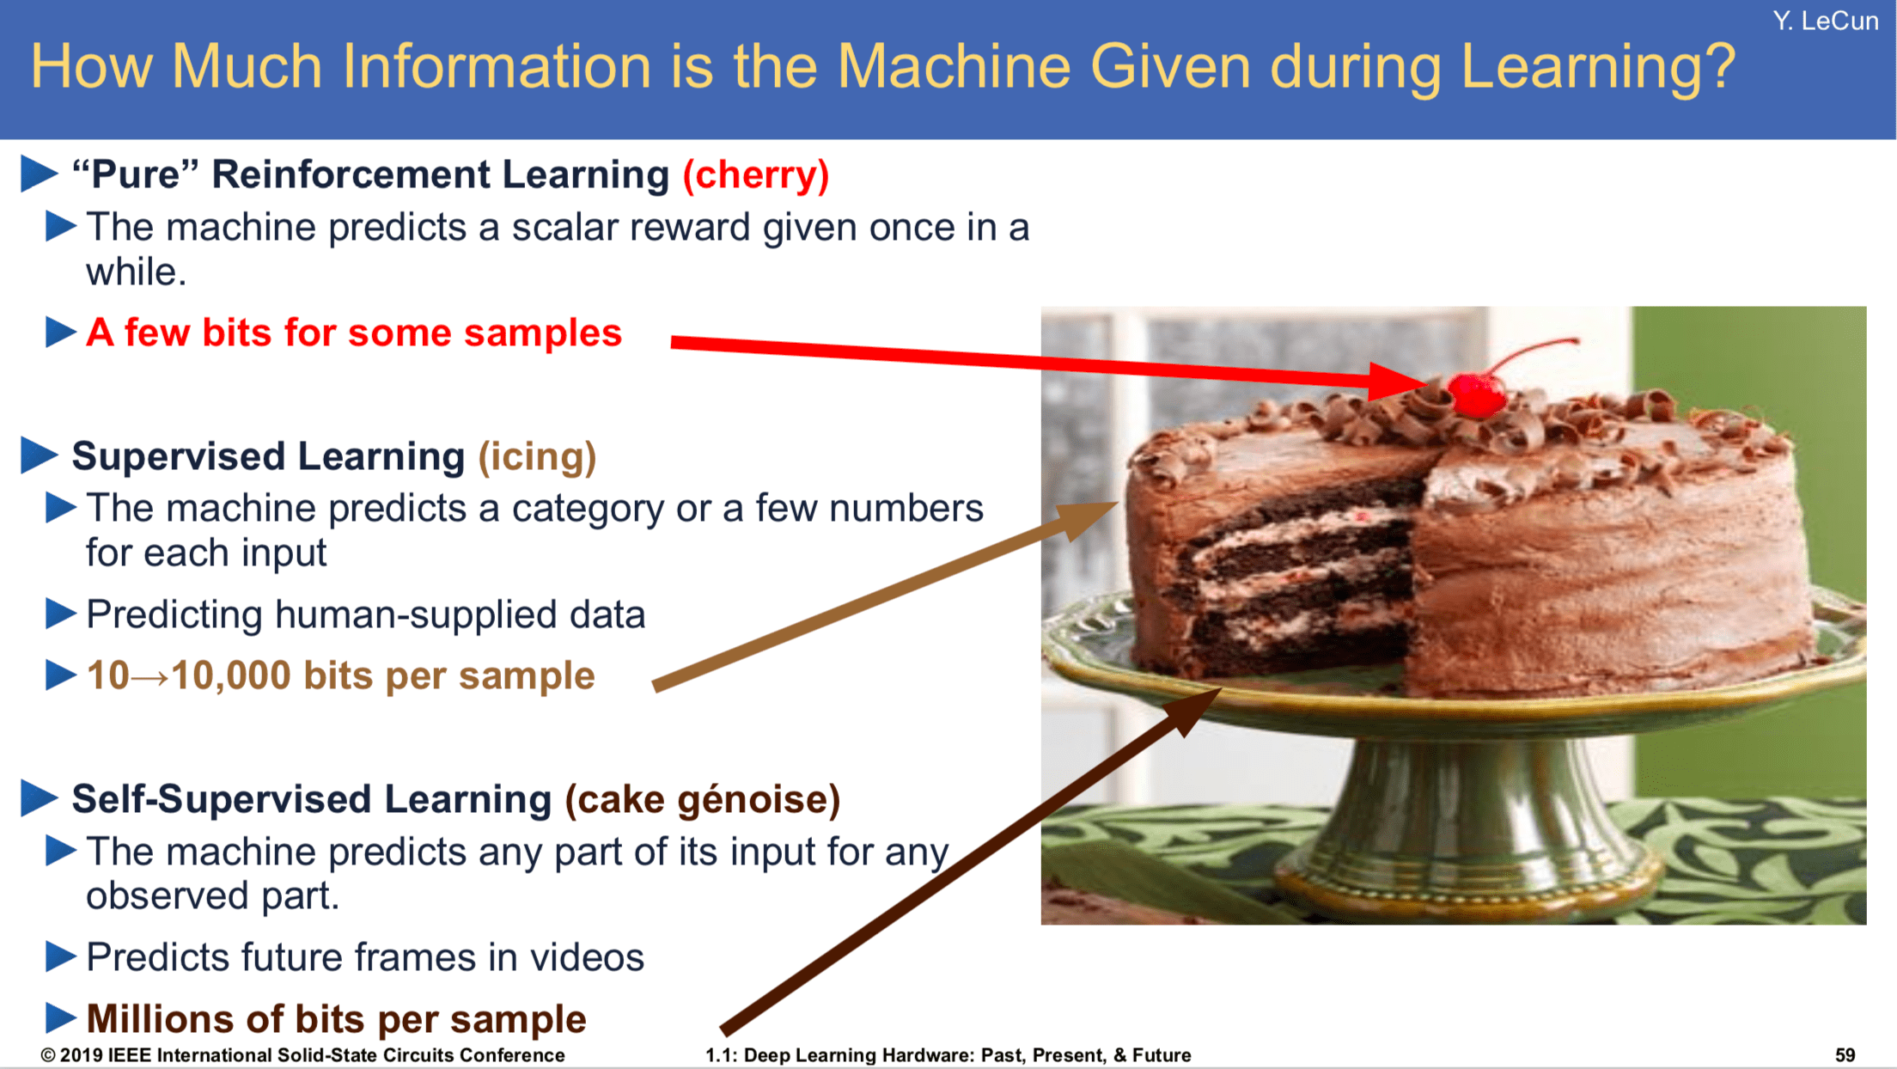

Slide 5
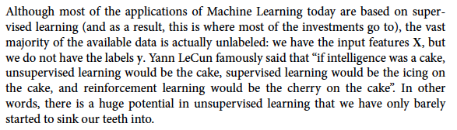
Unsupervised learning
the icing on the cake definition: 1. something that makes a good situation even better: 2. an unexpected additional good thing

Slide 6
Supervised learning vs. unsupervised learning
Supervised learning: discover patterns in the data that relate data attributes with a target (class) attribute.
These patterns are then utilized to predict the values of the target attribute in future data instances.
Unsupervised learning: The data have no target attribute.
We want to explore the data to find some intrinsic structures in them.

Slide 7
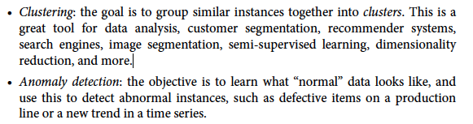
unsupervised learning tasks and algorithms:

Slide 8
Clustering
Clustering is a technique for finding similarity groups in data, called clusters. I.e., It groups data instances that are similar to (near) each other in one cluster and data instances that are very different (far away) from each other into different clusters.
Clustering is often called an unsupervised learning task as no class values denote a priori grouping of the data instances that are given, which is the case in supervised learning.
Due to historical reasons, clustering is often considered synonymous with unsupervised learning.

Slide 9
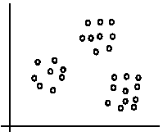
An illustration
The data set has three natural groups of data points, i.e., 3 natural clusters.

Slide 10
What is clustering for?
Let us see some real-life examples:
Example 1: groups people of similar sizes together to make “small”, “medium” and “large” T-Shirts. ☺
Tailor-made for each person: too expensive ☹
One-size-fits-all: does not fit all. ☹
Example 2: In marketing, segment customers according to their similarities
To do targeted marketing.

Slide 11
What is clustering for? (cont…)
Example 3: Given a collection of text documents, we want to organize them according to their content similarities,
To produce a topic hierarchy
In fact, clustering is one of the most utilized data mining techniques.
It has a long history and is used in almost every field, including medicine, psychology, botany, sociology, biology, archeology, marketing, insurance, and libraries.
In recent years, due to the rapid increase of online documents, text clustering has become important.

Slide 12
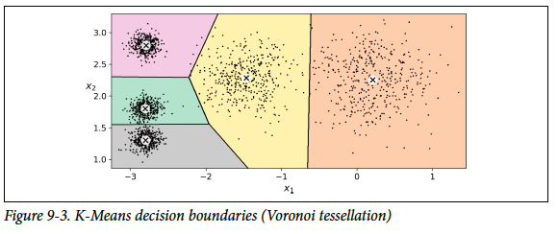
Clustering Algorithm
There is no universal definition of what a cluster is: it really depends on the context, and different algorithms will capture different kinds of clusters. For example, some algorithms look for instances centered around a particular point, called a centroid. Others look for continuous regions of densely packed instances: these clusters can take on any shape. Some algorithms are hierarchical, looking for clusters of clusters. And the list goes on.
In this class we will look at clustering algorithms K-Means

Slide 13
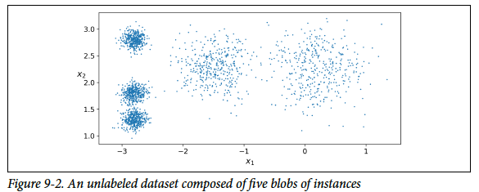
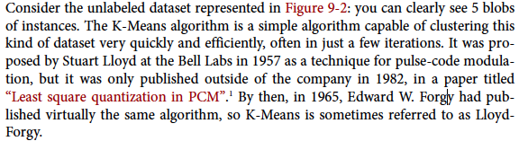

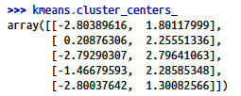
K-Means

Slide 14
K-means algorithm
Given k, the k-means algorithm works as follows:
Randomly choose k data points (seeds) to be the initial centroids, cluster centers
Assign each data point to the closest centroid
Re-compute the centroids using the current cluster memberships.
If a convergence criterion is not met, go to 2).

Slide 15
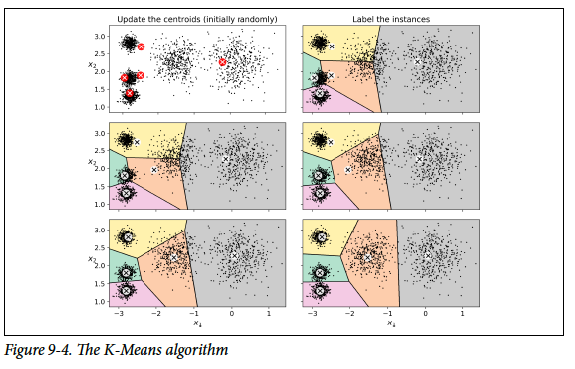
How does Clustering work?
start by placing the centroids randomly (e.g., by picking k instances at random and using their locations as centroids). Then label the instances, update the centroids, label the instances, update the centroids, and so on until the centroids stop moving. The algorithm is guaranteed to converge in a finite number of steps (usually quite small), it will not oscillate forever2. You can see the algorithm in action in Figure 9-4

Slide 16
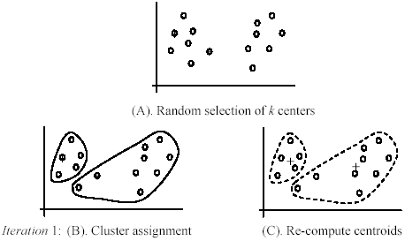
An example
+
+

Slide 17
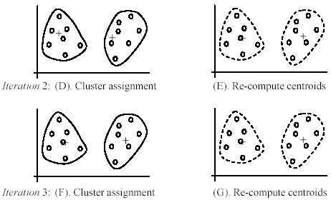
An example (cont …)

Slide 18
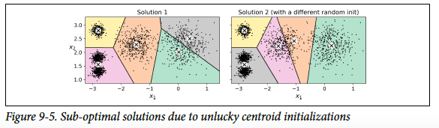
Not the right solution
Unfortunately, although the algorithm is guaranteed to converge, it may not converge to the right solution (i.e., it may converge to a local optimum): this depends on the centroid initialization. For example, Figure 9-5 shows two sub-optimal solutions that the algorithm can converge to if you are not lucky with the random initialization step
So, we need Centroid Initialization Methods.

Slide 19
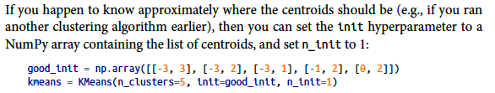

Centroid Initialization Methods
But how exactly does it know which solution is the best? Well, of course, it uses a performance metric! It is called the model’s inertia: this is the mean squared distance between each instance and its closest centroid.
It is roughly equal to 223.3 for the model on the left of Figure 9-5, 237.5 for the model on the right of Figure 9-5, and
211.6 for the model in Figure 9-3. The Kmeans class runs the algorithm n_init times and keeps the model with the lowest inertia: in this example, the model in Figure 9-3 will be selected

Slide 20
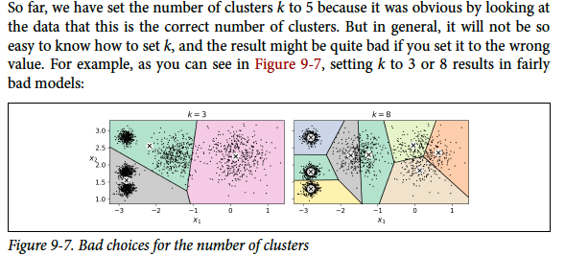
Finding the Optimal Number of Clusters

Slide 21
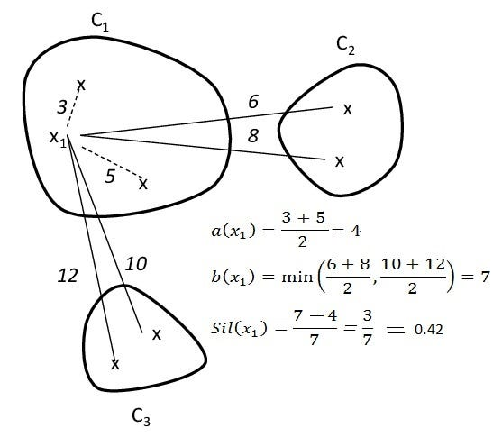
How to choose the number of clusters
Unfortunately, it is not that simple. The more clusters there are, the closer each instance will be to its closest centroid and, therefore, the lower the inertia will be.
Use the silhouette score, which is the mean silhouette coefficient over all the instances. An instance’s silhouette coefficient is equal to (b – a) / max(a, b) where a is the mean distance to the other instances in the same cluster (it is the mean intra-cluster distance), and b is the mean nearest-cluster distance, that is the mean distance to the instances of the next closest cluster (defined as the one that minimizes b, excluding the instance’s own cluster).

Slide 22
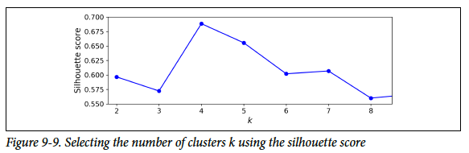
Using Silhouette score
The silhouette coefficient can vary between -1 and +1: a coefficient close to +1 means that the instance is well inside its own cluster and far from other clusters. In contrast, a coefficient close to 0 means that it is close to a cluster boundary, and finally, a coefficient close to -1 means that the instance may have been assigned to the wrong cluster.
To compute the silhouette score, you can use Scikit-Learn’s silhouette_score() function, giving it all the instances in the dataset, and the labels they were assigned:
As you can see, this visualization is much richer than the previous one: in particular, although it confirms that k=4 is a very good choice, it also underlines the fact that k=5 is quite good as well, and much better than k=6 or 7. This was not visible when comparing inertias.

Slide 23
Limits of K-Means
Despite its many merits, most notably being fast and scalable, K-Means is not perfect.
As we saw, the algorithm must be run several times to avoid sub-optimal solutions, and you need to specify the number of clusters, which can be quite a hassle.
Moreover, K-Means does not behave very well when the clusters have varying sizes, different densities, or non-spherical shapes.
Note: It is important to scale the input features before you run K-Means, or else the clusters may be very stretched, and K-Means will perform poorly. Scaling the features does not guarantee that all the clusters will be nice and spherical, but it generally improves things.

Slide 24
Weaknesses of k-means
The algorithm is only applicable if the mean is defined.
For categorical data, k-mode - the centroid is represented by most frequent values.
The user needs to specify k.
The algorithm is sensitive to outliers
Outliers are data points that are very far away from other data points.
Outliers could be errors in the data recording or some special data points with very different values.

Slide 25
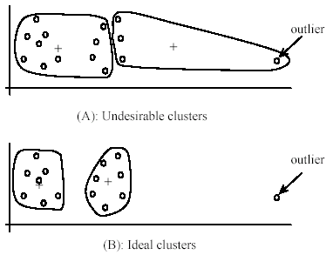
Weaknesses of k-means: Problems with outliers

Slide 26
Weaknesses of k-means: To deal with outliers
One method is to remove some data points in the clustering process that are much further away from the centroids than other data points.
To be safe, we may want to monitor these possible outliers over a few iterations and then decide to remove them.
Another method is to perform random sampling. Since in sampling we only choose a small subset of the data points, the chance of selecting an outlier is very small.
Assign the rest of the data points to the clusters by distance or similarity comparison, or classification

Slide 27
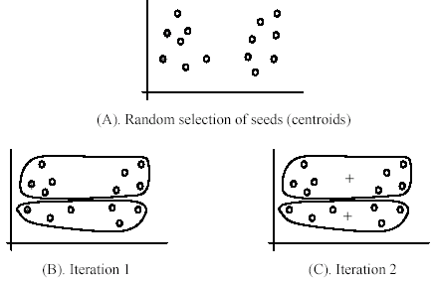
Weaknesses of k-means (cont …)
The algorithm is sensitive to initial seeds.

Slide 28
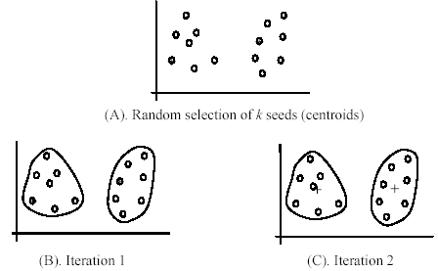
Weaknesses of k-means (cont …)
If we use different seeds: good results
There are some methods to help choose good seeds

Slide 29
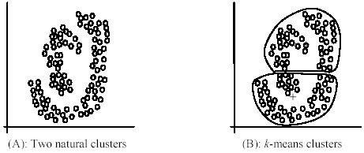
Weaknesses of k-means (cont …)
The k-means algorithm is not suitable for discovering clusters that are not hyper-ellipsoids (or hyper-spheres).
+

Slide 30
K-means summary
Despite weaknesses, k-means is still the most popular algorithm due to its simplicity, efficiency and
other clustering algorithms have their own lists of weaknesses.
No clear evidence that any other clustering algorithm performs better in general
although they may be more suitable for some specific types of data or applications.
Comparing different clustering algorithms is a difficult task. No one knows the correct clusters!

Slide 31
Dimensionality Reduction

Slide 32
Overview
One of the common problems in machine learning is ‘Overfitting’, where the model remembers all the training data, including noise and other unrelated features, predicts higher accuracy on training data, but does not generalize well to the new dataset.
Key reason for overfitting is that the model is too complex relative to the amount and noisiness of the training data.
How to solve overfitting?
The model can be simplified by selecting simple algorithms, reducing the number of parameters used, or removing noise in the training data, e.g., outliers.

Slide 33
Dimensionality Reduction
In order to reduce complexity by reducing features/ dimensions,
Dimensionality reduction plays a critical role by projecting the dataset onto a lower-dimensional space.
In other words, dimension reduction is basically a pre-processing step for machine learning that reduces the dimension of the dataset.
It is essential to come up with a good set of features to train by: – Add / Discard features – Derive new feature space

Slide 34

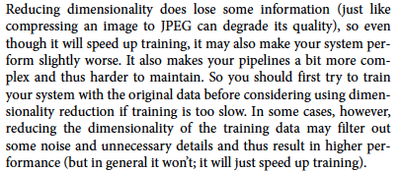
The Curse of Dimensionality

Slide 35
Feature Engineering
1. Feature Selection
It includes creation of subset from the original dataset which includes selecting the most useful feature to train and has lower prediction error than on full model. In this process, some variables are retained or discarded.
2. Feature Extraction
This involves reducing or transforming the data to a lower dimensional space with most relevant information / features.
Common feature extraction methods are:
PCA (Principal Component Analysis)
LDA (Linear Discriminant Analysis) we will not talk about this in the current course

Slide 36
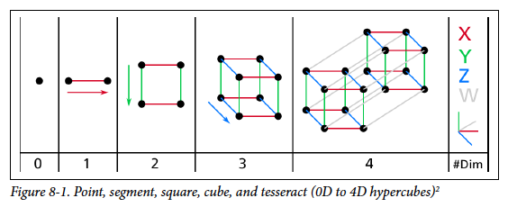
Dimensionality reduction
It reduces the dimensions of a d-dimensional dataset by projecting it onto a (k)-dimensional subspace (where k<d) in order to increase the computational efficiency while retaining most of the information.
Dimensionality reduction implies information loss !!
Transformation
This transformation is defined so that the first principal component has the largest possible variance, and each succeeding component, in turn, has the next highest possible variance.

Slide 37
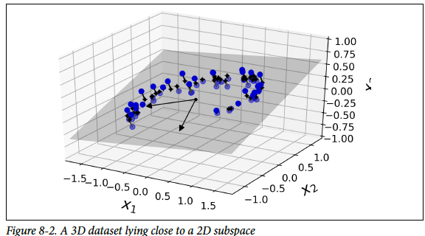
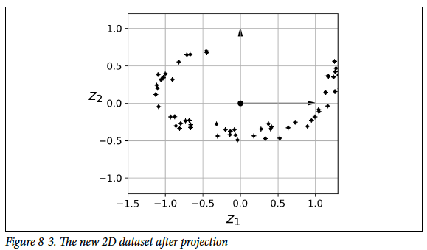
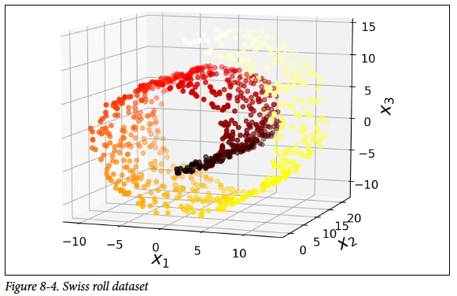
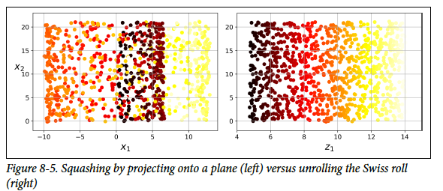
Two Approaches for Dimensionality Reduction
Projection
Manifold Learning

Slide 38
How Does PCA Work?
Principal Component Analysis (PCA) is an unsupervised learning algorithm that ignores the class labels. We need to find (the so-called principal components) that maximize the variance in a dataset to find the directions.
To obtain quality/type of coffee, we can use different features of coffee such as its sweetness value, color of coffee, place of coffee and so on, however, many of these features will be redundant or dummy feature variables (can be derived from other features), therefore causing to train model on unnecessary features. In short, we can get the type of coffee with fewer feature variables, and this is what PCA actually does inside the box.
Note that PCA does not select a set of features and discard other features; rather, it infers some new features that best describe the type of class from the existing features.
First, it identifies the hyperplane that lies closest to the data and then projects the data onto it. In other words, PCA is basically the summarization of data.

Slide 39
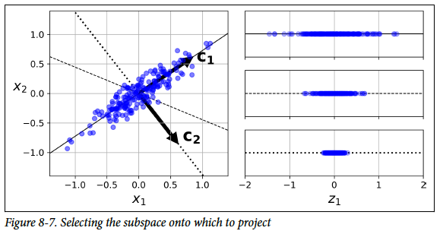
How Does PCA Work?
On the right is the result of the projection of the dataset onto each of these axes. As you can see, the projection onto the solid line preserves the maximum variance, while the projection onto the dotted line preserves very little variance, and the projection onto the dashed line preserves an intermediate amount of variance.
It seems reasonable to select the axis that preserves the maximum amount of variance, as it will most likely lose less information than the other projections.

Slide 40
Let’s Perform the PCA and analyze the graph:
1. Loading the dataset to the memory and performing feature extraction. 2. Scaling the dataset – Can use min-max normalization for scaling the dataset with mean zero and a unit standard deviation. 3. Apply PCA with inbuilt PCA function in sklearn:
from sklearn.decomposition import PCA pca = PCA (n_components=2) X_feature_reduced = pca.fit(X).transform(X)
Here, ‘X’ is the training dataset and ‘n_component’ is the number of PCA components we want to derive from our existing feature set.
So using the sklearn, PCA is like a black box (black box working explained above), you give scaled feature set as an input to sklearn PCA and get PCA components as output which can be used as an input to data training algorithms.

Slide 41
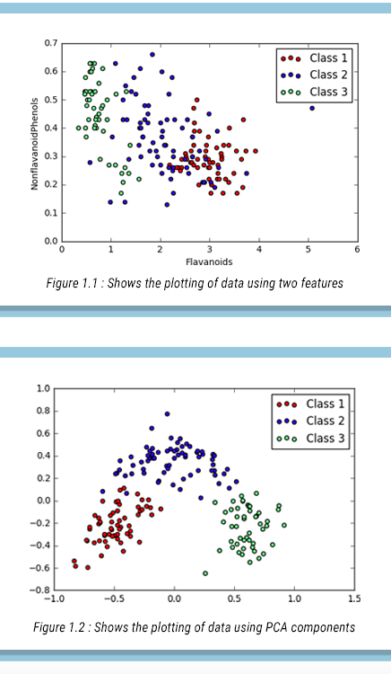
The graph above shows the plotting of data points using two features vs. the Plotting of data points using principal components (which is basically a summarization of all the features in our dataset)

